Slide 1

Mining Financial Data
By:
SJ Analytics
Jorge Polanco
Samuel dela Cruz
Notes:
Hello, welcome to our presentation. Our team’s name is SJ Analytics. I’m Sam. And (Jorge introduces himself). Today, we’re presenting our data exploration and analysis of Financial Data that we downloaded from Lending Club. (next slide)

Slide 2
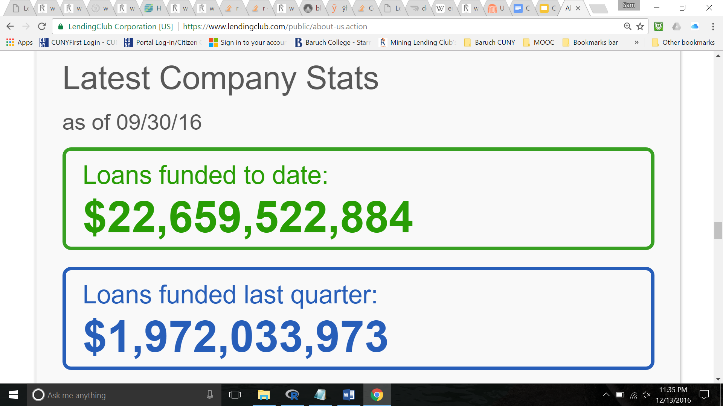
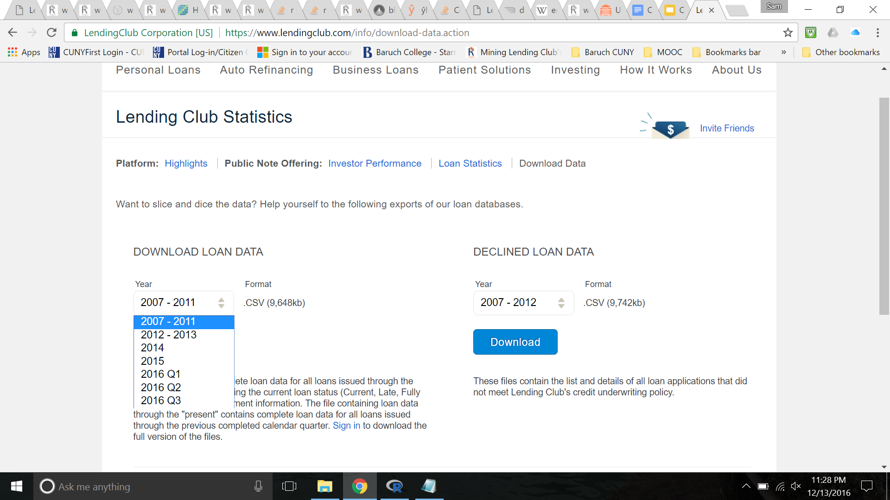
Source
Notes:
So, just to speak very briefly about our data source. Lending Club is an online peer-to-peer lending company. What that means is that borrowers apply online for a loan and other people (or investors) fund these loans directly. Just to highlight the impact of this website, not just in fintech, but also on the financial market as a whole, the company has funded more than $22 billion in loans. Almost $2bil JUST in the second quarter of 2016. (next slide)

Slide 3
Types of Analyses
Investors:
Predict Risks
Predict Returns
Borrowers:
Predict Grade
Predict Interest Rate
Lending Club:
Marketing
Consumer Behavior
Notes:
With the trove of data that anyone can download directly from the company’s website, we can do an endless number of analyses for different types of audiences. (Read slide) (Next Slide)

Slide 4
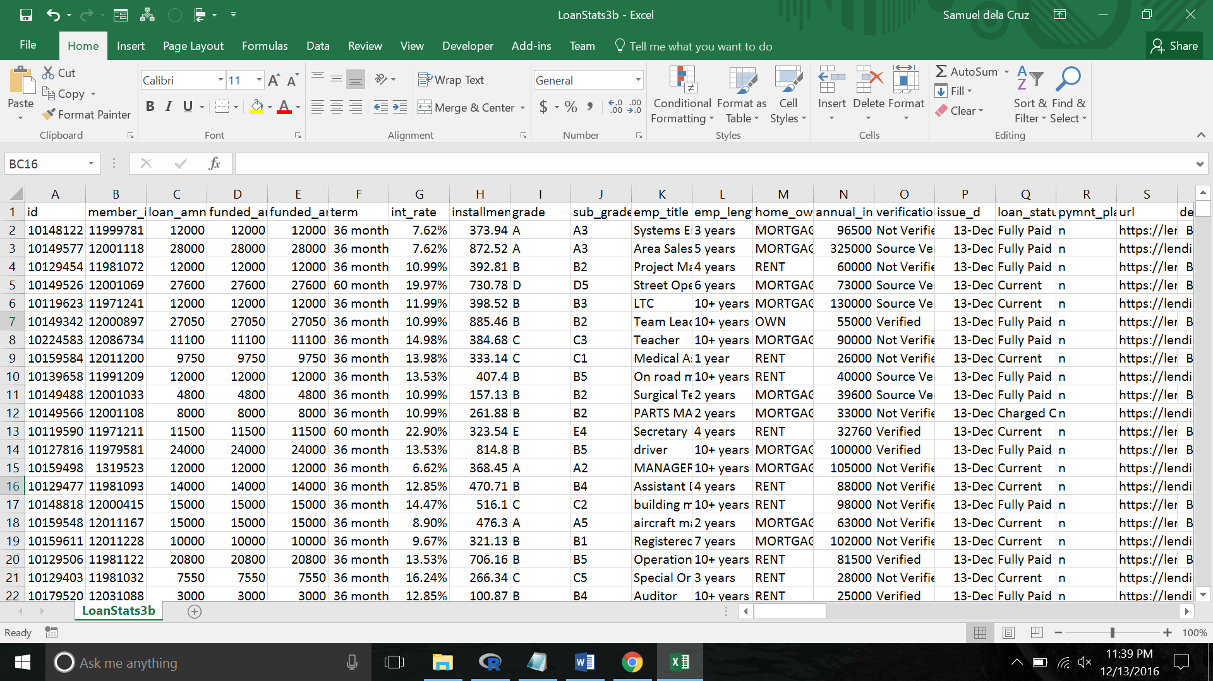
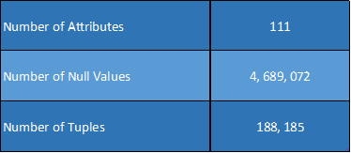
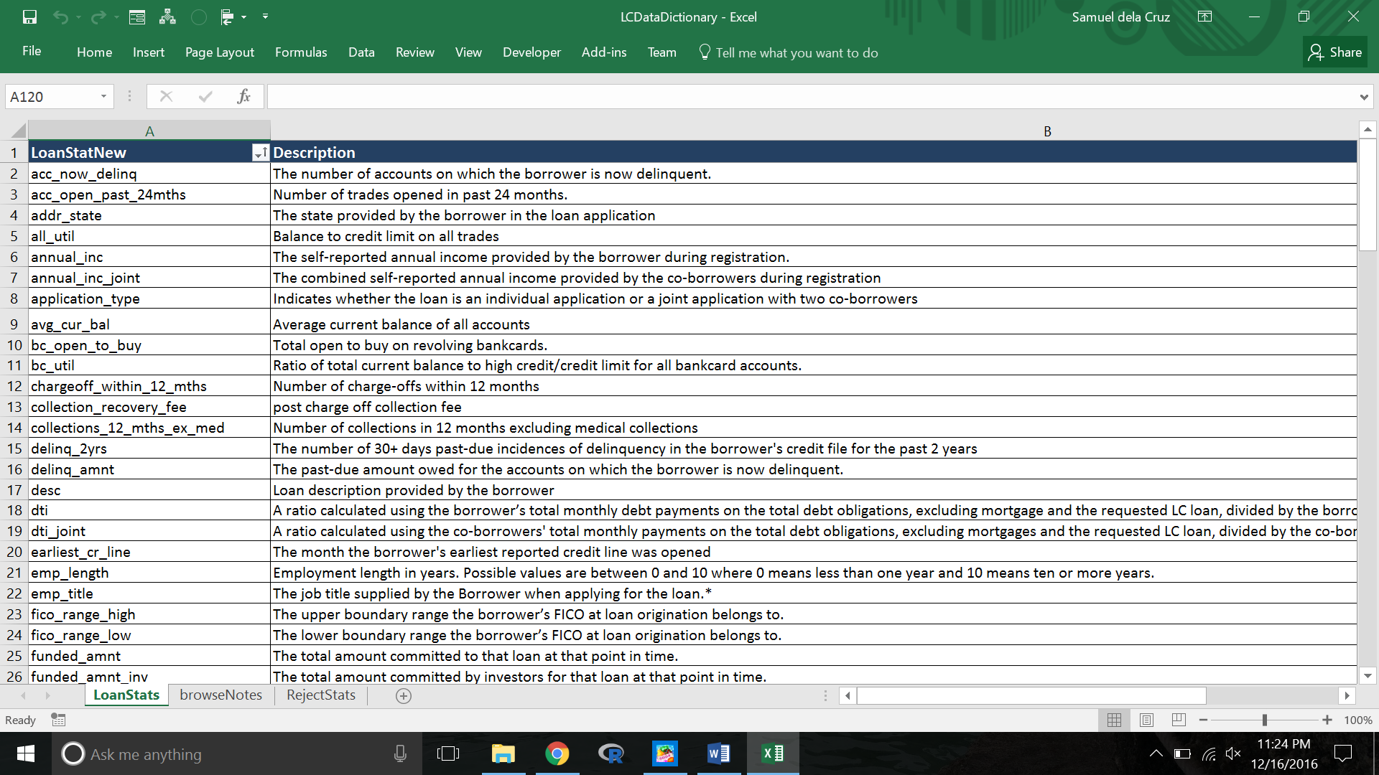
Preliminary Data Exploration
Notes:
So, as soon as we opened one of the files that we downloaded from the website, we realized the enormity of the data. After running simple codes on R, we saw that (read blue chart on slide). Naturally, it just made sense that LC would provide a data dictionary because it is definitely necessary, just to try to parse out the individual attributes.

Slide 5
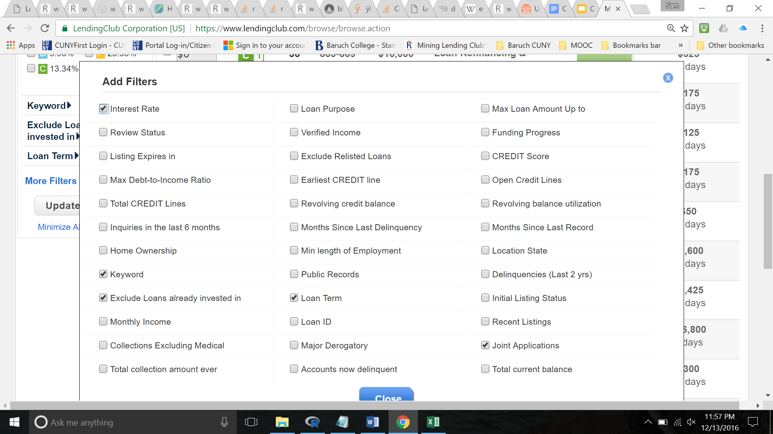
Winnowing Down Important Variables
Notes:
So, our job was set for us to clean the data. How did we decide on the important attributes? Fortunately, LC has a filter for investors but the company limits the variables to only 40 or so different attributes.

Slide 6
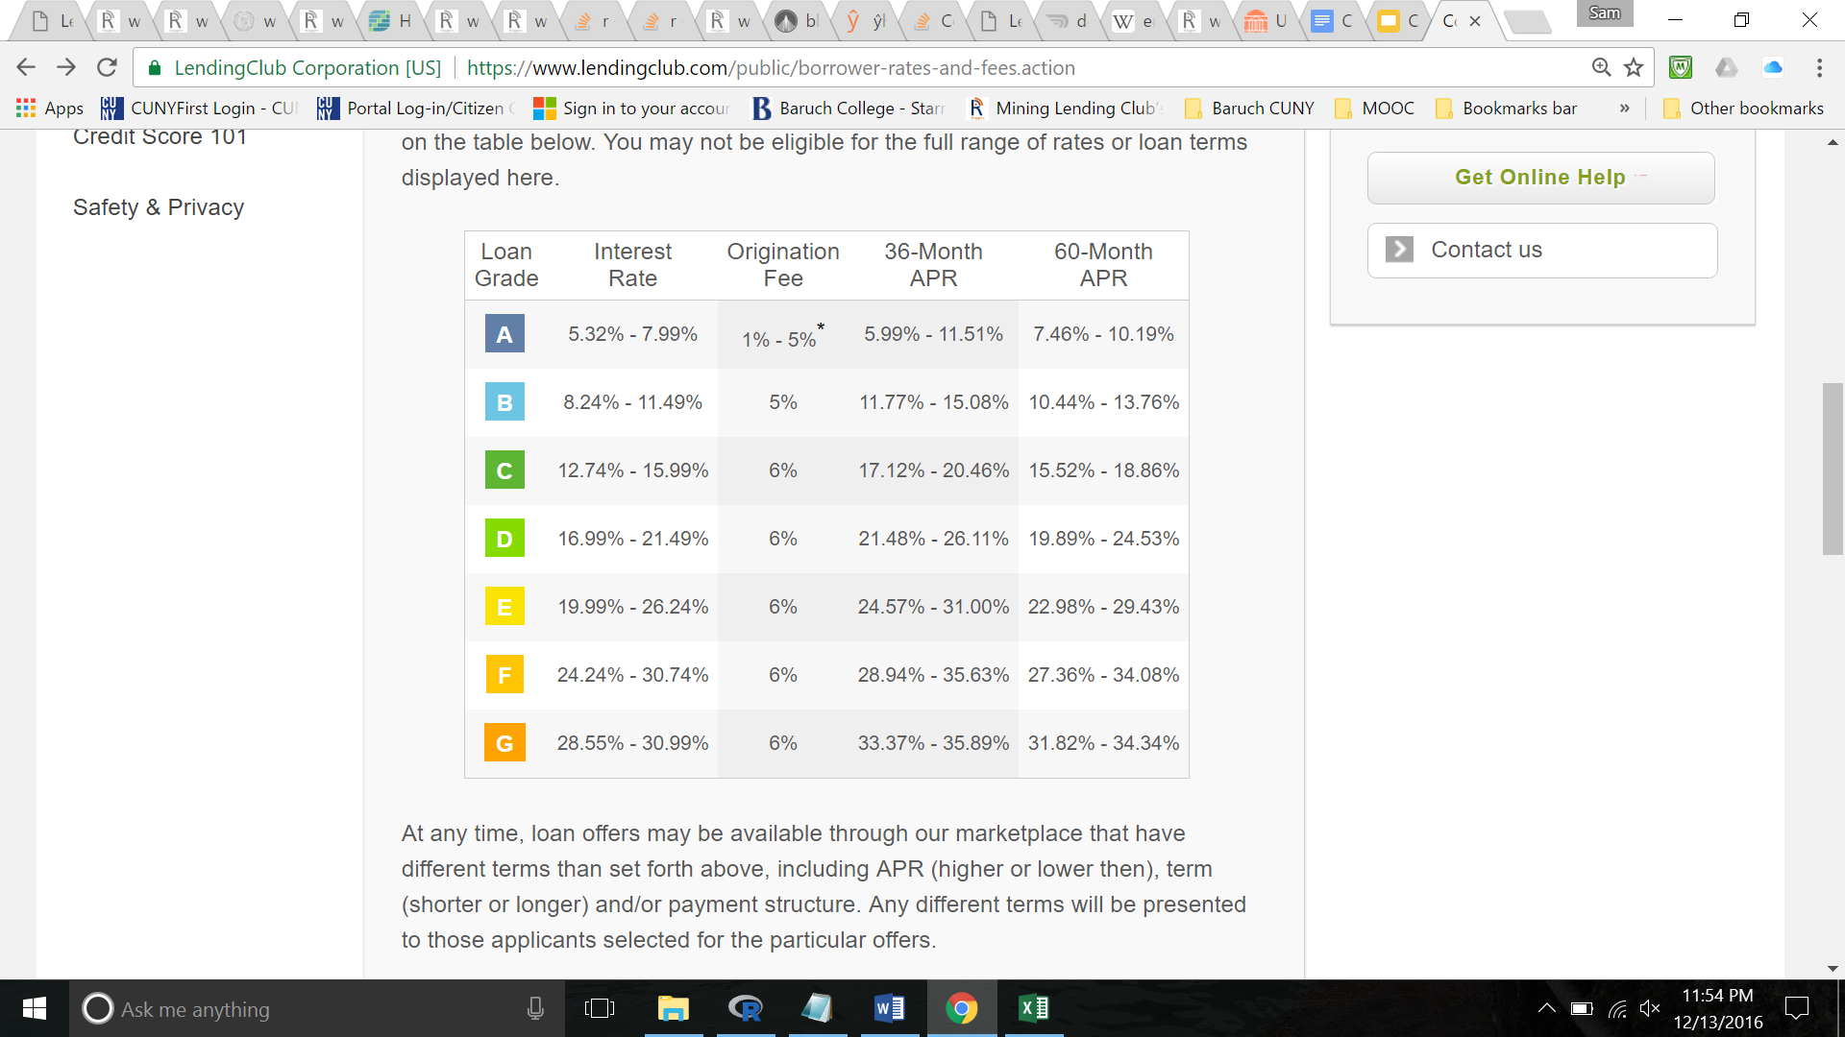
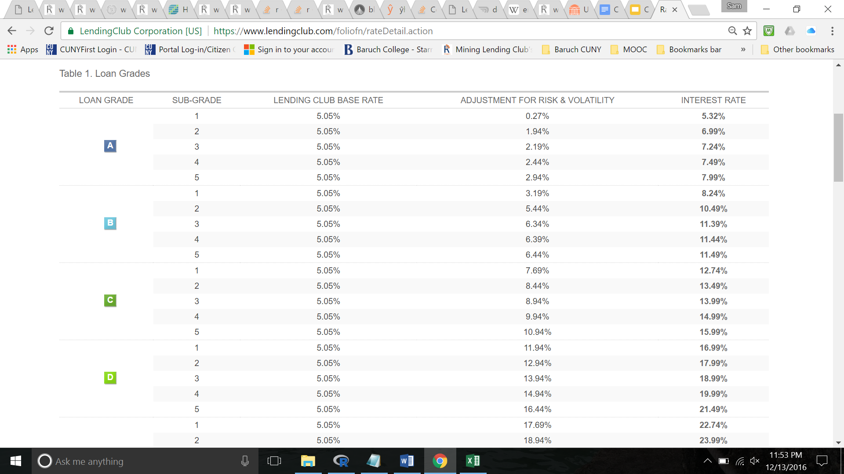
Developing Prediction Model: Interest Rates
Notes:
So, now, for my own analysis, I created multiple regression models to predict interest rate. I actually stumbled upon this after playing around with different types of preliminary data analysis. I was running some simple pairwise plots and histograms and I noticed that although Grade directly corresponds to a particular interest rate, there are some observations that do not follow expectations. (next slide)

Slide 7
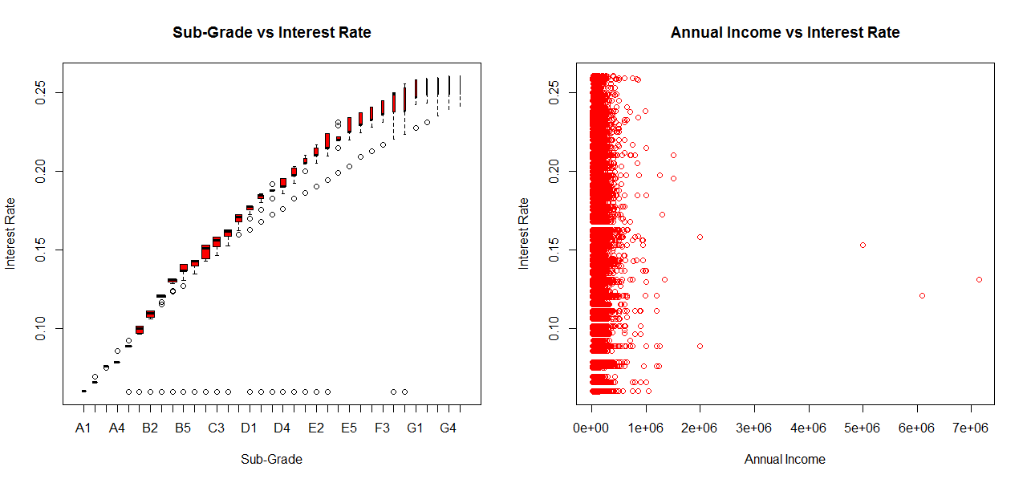
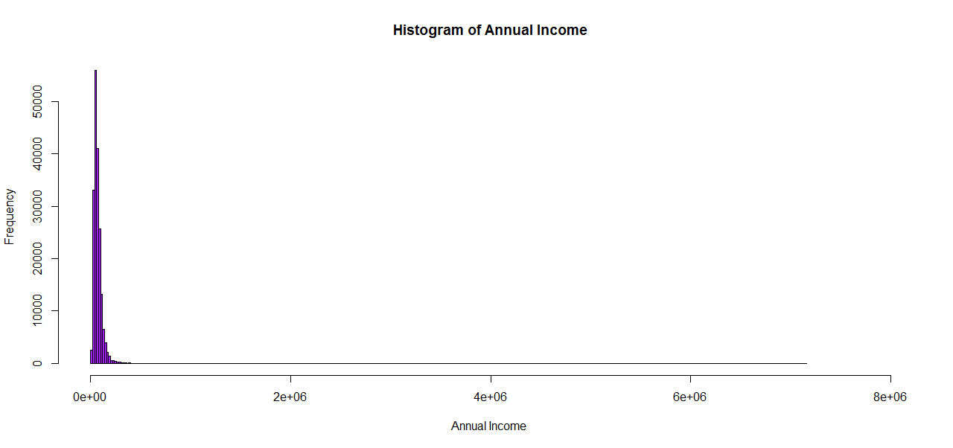
Collinearity and Outliers
Notes:
If we look at the bar plot on the top left side, the graph confirms the collinearity between interest rate and sub-grade. Also, there are observations that are way outside the range for many of the subgrade categories, so I tried to take a mental note of these outliers. We likewise see extreme outliers on the graph of Annual Income and Interest Rates. Of course, we ran preliminary data analyses on R so we were aware of these observations. (next slide)

Slide 8
Cleaning Data Further
> names(LC2013)
[1] "LoanAmount” "InterestRate" "AnnuaLincome" "DTI"
[5] "SubGrade" "YearsWorking" "HomeOwnership" "Verification"
[9] "LoanStatus" "Purpose" "State" "Term"
> positions <- sample(nrow(LC2013), size = floor((nrow(LC2013)/100) * 3))
> training <- LC2013[positions, ]
> testing <- LC2013[-positions, ]
> dim(training)
[1] 5599 12
Notes:
So, before developing my model. I pared down my variables even further. Because of the greatness in size of the data set, it is also important to do some sampling of data. My final training set only has almost 6,000 observations. This is definitely much smaller than the original data set, but it’s a number that is more manageable by R. (next slide)

Slide 9
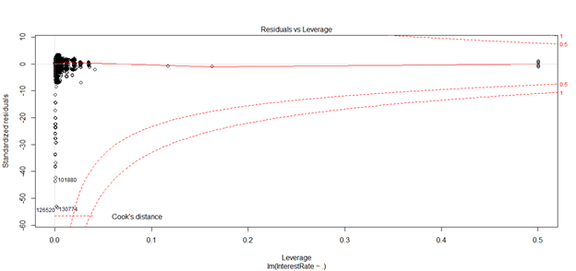
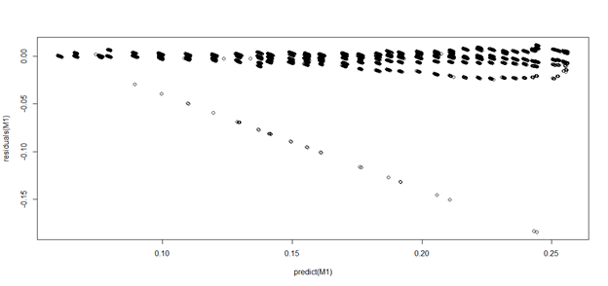
High Leverage Points
Notes:
So, I ran a model with Interest Rate as the predicted value and all the remaining attributes as predictors and this is what came out after plotting the multiple regression model. Again, we see that the graph has very extreme outliers. But the graph also shows that there are observations with significant leverage values, which means that these unusual observations could potentially be influencing our model to predict Interest Rate. In contrast to outliers, high leverage points tell us something about our x values instead of y. I must also acknowledge that I used some predictors that were just simple noise. (next slide)

Slide 10
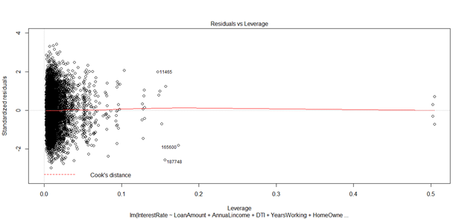
Cutting Out Noise
Call:
lm(formula = InterestRate ~ LoanAmount + AnnuaLincome + DTI + YearsWorking + HomeOwnership + Verification + Purpose + State +Term, data = training)
Residual standard error: 0.03658 on 5523 degrees of freedom
Multiple R-squared: 0.3292, Adjusted R-squared: 0.3201
F-statistic: 36.14 on 75 and 5523 DF, p-value: < 2.2e-16
Notes:
So, I cut out SubGrade and Loan Status in the new model. My R Squared is 32.92% so it’s not a very strong model. Unfortunately, what I believe would have been a strong predictor is missing from our data set. Just to let you know, this is actually a very popular data set amongst data miners. Many in academia and professional data scientists have done some data analysis using the data sets provided by the Lending Club. Based on my research online, I read that FICO scores had been available in previous years. However, I downloaded all the data sets currently available and these numbers are not given in the excel sheets online. Nevertheless, if you’re an investor, the FICO score range for a borrower can be viewed through a simple search on the lending club website. Sadly, it would be a significantly daunting task to collect all these data on my own. I also have to acknowledge a caveat that, with the data set provided by LC, I could recreate my own FICO score by aggregating the values of several different factors such as credit history, DTI, revolving balance, annual income, open accounts, etc.
Going back to the graph, we also still see slightly high leverage points and we still see outliers. (next slide)

Slide 11
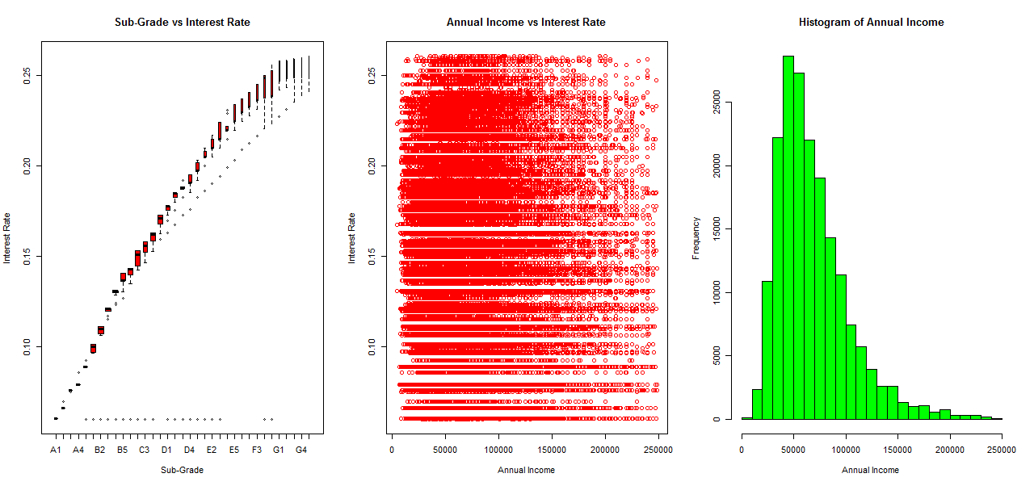
Cutting Out Wealthy Borrowers
Notes:
To eliminate outliers, you can use statistical data. Jorge will actually address this issue shortly in his own analysis. However, for my part, I actually just used arbitrary measures. I pinpointed earlier that there were extreme outliers when it comes to annual income. So, little by little, I reduced the data frame based on income until that reduction created a significant change in my R Squared number. I ended up with $250K as my ceiling, and it’s kind of a little intuitive if you think about it. The top 10% earners in the United States make about that much in income.

Slide 12
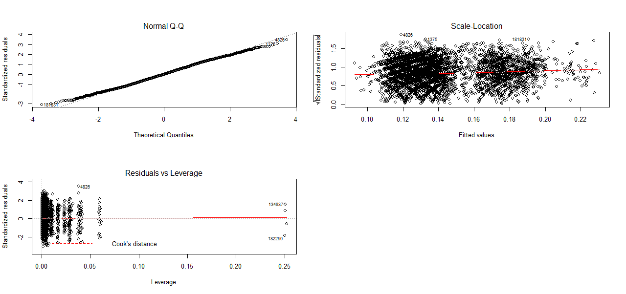
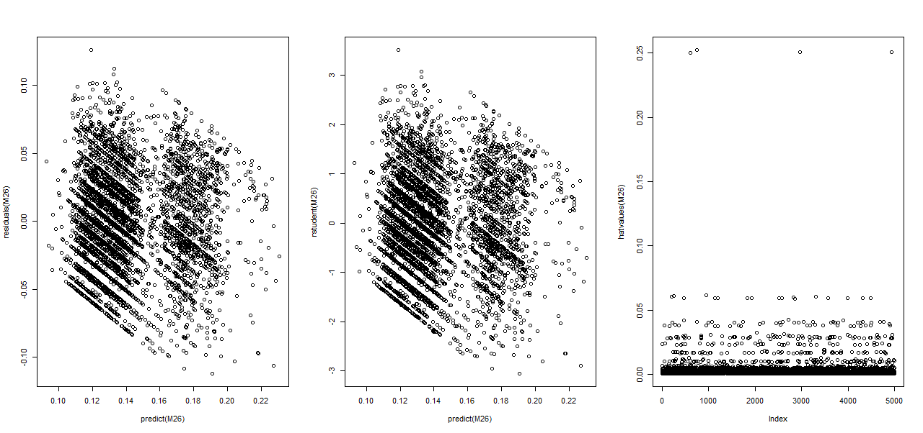
Final Model
Notes:
So, these are the plots for my final model. We see that there is actually still one observation that’s on the borderline for being an outlier. We also reduce leverage points. I also plotted predicted values vs residual, and blah blah (need to add more!!!!!)

Slide 13
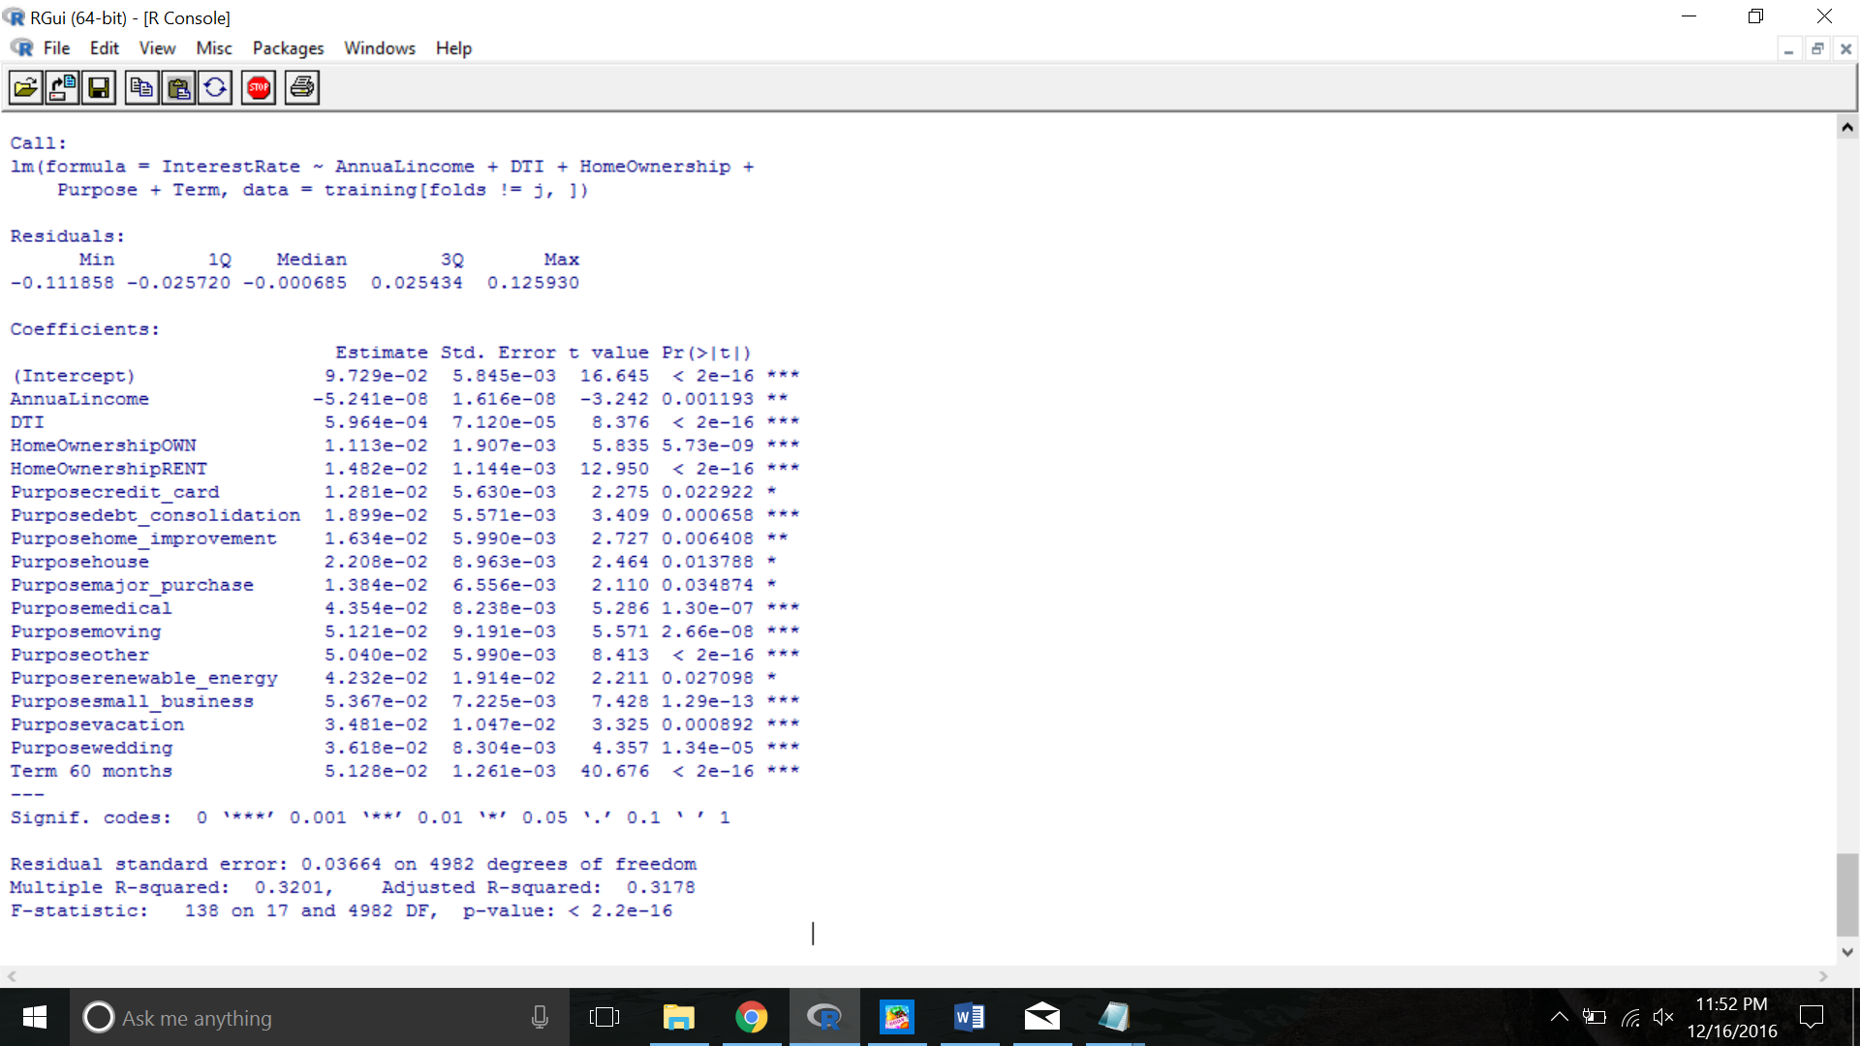
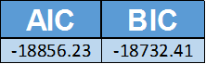
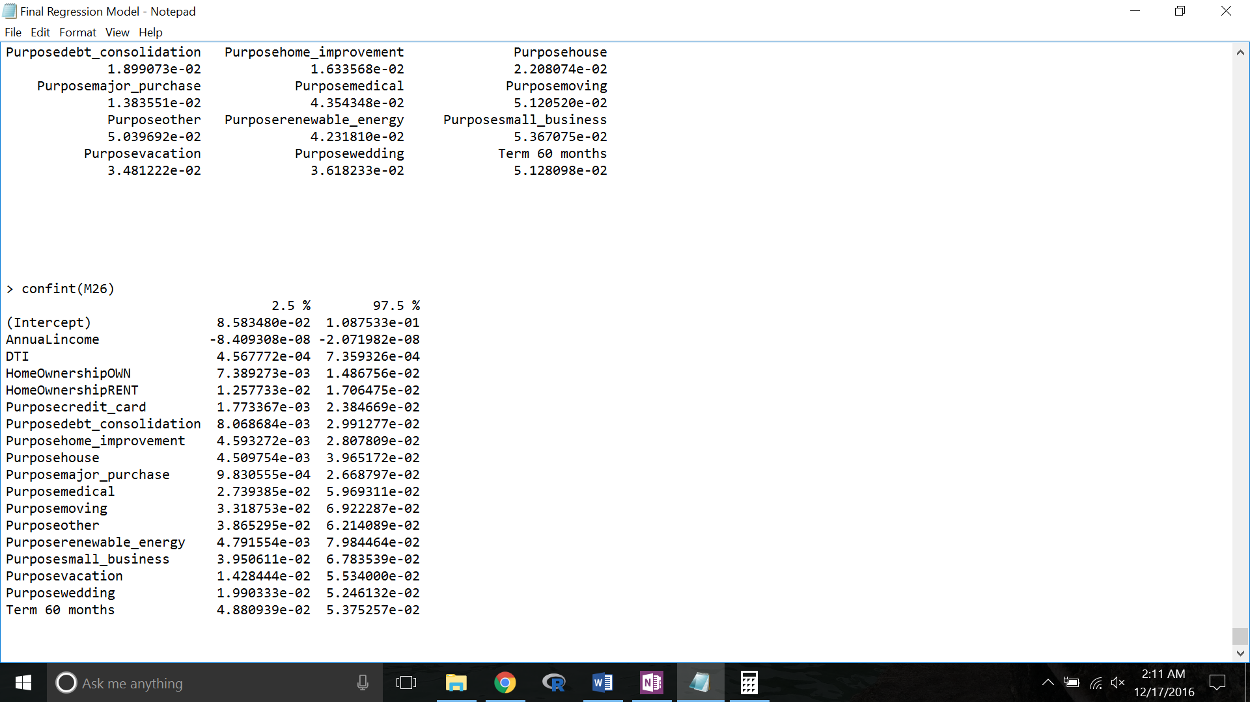
Final Model
Notes:
What’s interesting according to my final model is that loan amount is actually not a strong determinant for interest rate. As expected, an increase in annual income can reduce the interest rate on your loan. Perhaps, one reason why some observations are throwing off the model in the beginning is because there are some instances where a very high earner is paying a significantly higher interest rate on a loan. Also, it saves to own a home as compared to renting. A high earner and a home earner are both seen as fairly safe debtors. Now, LC actually penalizes rather heavily for term of loan. We actually don’t need the model to tell us this. LC has its own chart to tell that time value of money is an important risk to investors. Finally, if you look down the numbers for the different purpose categories, it’s interesting to read what they think is a safer risk. For example, blah blah.

Slide 14
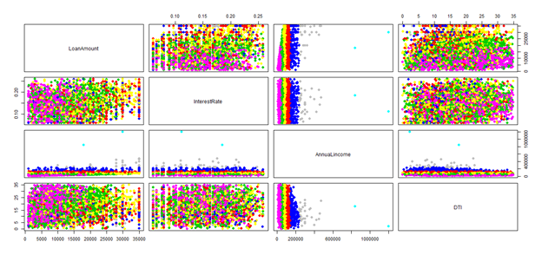
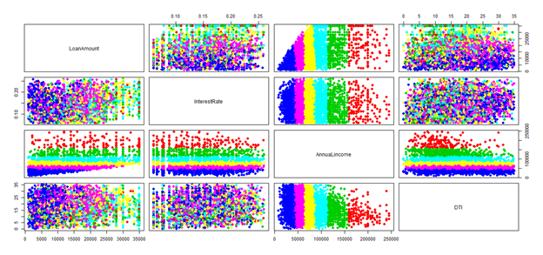
Clustering
Notes:
Before I hand over the reigns to Jorge, I just want to share some interesting observations that I found after playing around with the data. I did some clustering analysis and there isn’t really any significant grouping except in terms of income.

Slide 15
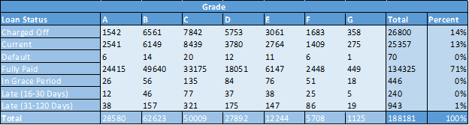
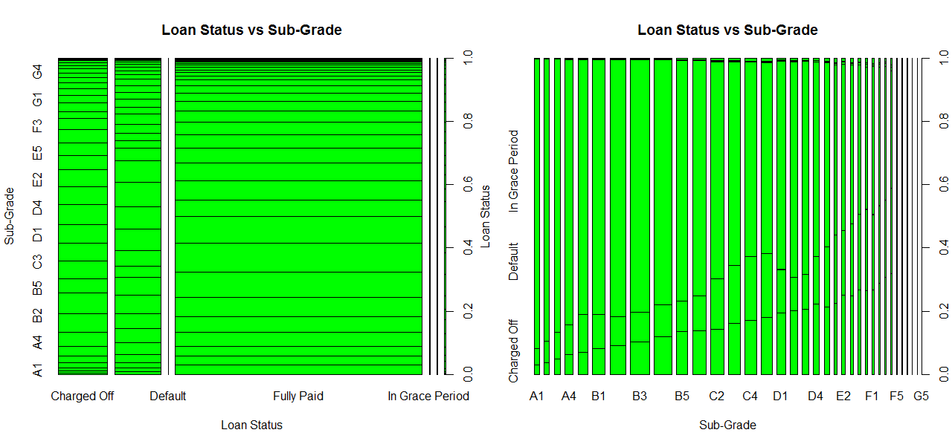
Loan Status Based on Grade
Notes:
Finally, this actually ties perfectly to Jorge’s next slide, but it’s quite remarkable that LC has a very large percentage of faithful borrowers. 71% of the data set shows that borrowers fully paid off their loans. Although not enough consolation to those investors who lose their investments, only 14% of borrowers actually don’t pay off their loans. Now, if we think that this data set could potentially represent a very large total loan amounts, 14% of even 100 million is still $ 14 million. Now, to Jorge.

Slide 16
Classification of Rare Events
What is a rare event?
84.2% of the data classified as PAID OFF and 15.8% classified as CHARGED OFF
Approach:
Decision Tree
Random Forest
Generalized Linear Model

Slide 17
Random Forest
Responsive Variable:
CHARGED OFF: 15.8% PAID OFF: 84.2% (n: 96,448)
Model:
d1.rf <- randomForest(rf.form, trainSplit, ntree= 500, importance= T, na.action = na.omit)
Variables used: target ~
- Funded_amnt
- term
- int_rate
- risk
- home_ownership
- annual_inc
- addr_state
- dti
- delinq_2yrs
- open_acc
- revol_bal
- revol_util
- acc_now_delinq
- avg_cur_bal
- bc_util
- mort_acc
- mths_since_recent_bc
- num_actv_bc_tl
- num_bc_sats
- num_sats
- pct_tl_nvr_dlq
- total_bc_limit
- pub_rec_bankruptcies - int_rate

Slide 18
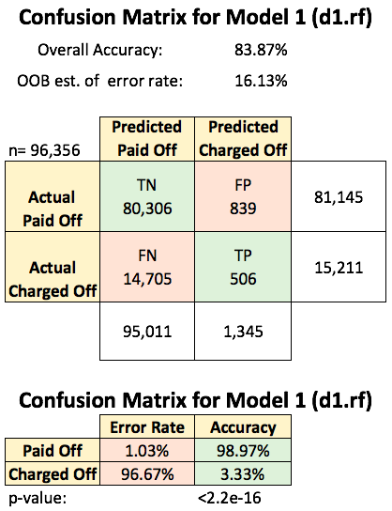
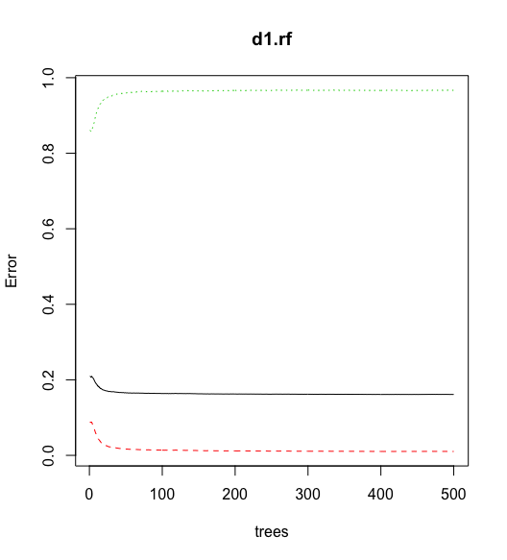
Random Forest Results

Slide 19
SMOTEd Random Forest
Responsive Variable:
CHARGED OFF: 50% PAID OFF: 50% (n: 54,144)
Model:
d2.rf <- randomForest(rf.form, trainSplit, ntree= 500, importance= T, na.action = na.omit)
Variables used: target ~
- Funded_amnt
- term
- int_rate
- risk
- home_ownership
- annual_inc
- addr_state
- dti
- delinq_2yrs
- open_acc
- revol_bal
- revol_util
- acc_now_delinq
- avg_cur_bal
- bc_util
- mort_acc
- mths_since_recent_bc
- num_actv_bc_tl
- num_bc_sats
- num_sats
- pct_tl_nvr_dlq
- total_bc_limit
- pub_rec_bankruptcies - int_rate

Slide 20
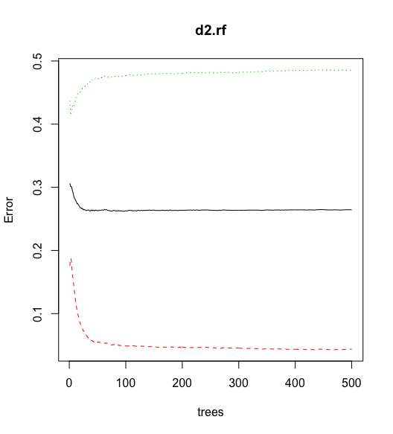
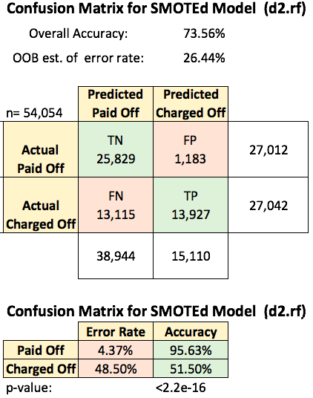
SMOTEd Random Forest Results

Slide 21
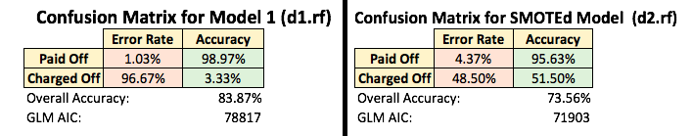
Model Comparison

Slide 22
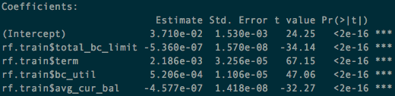
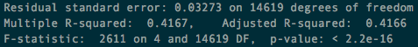
Predicting Interest Rates
Linear Model

Slide 23
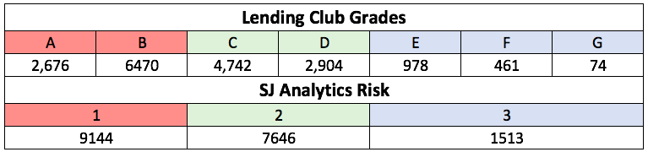
Predicting Interest Rates
K-means
Problems:
Too many values
Too many clusters
Lack of consistency

Slide 24
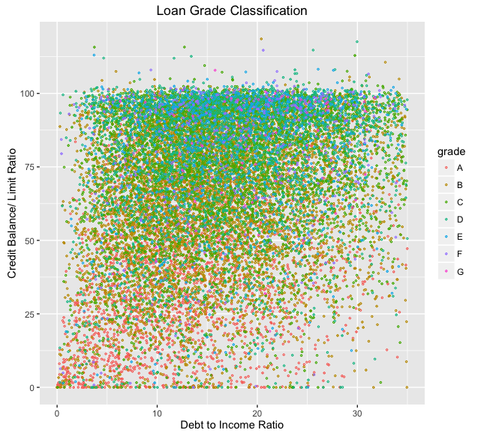

Slide 25
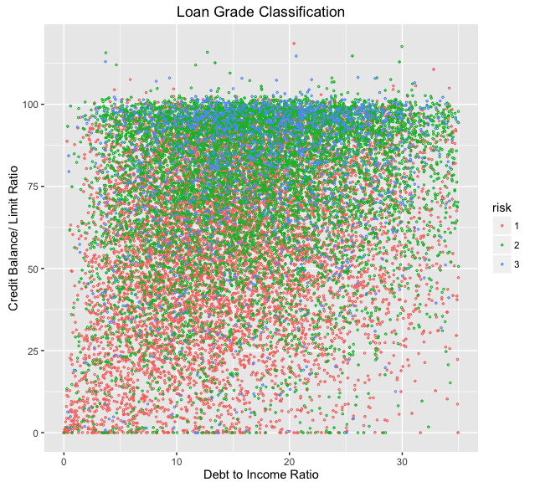

Slide 26
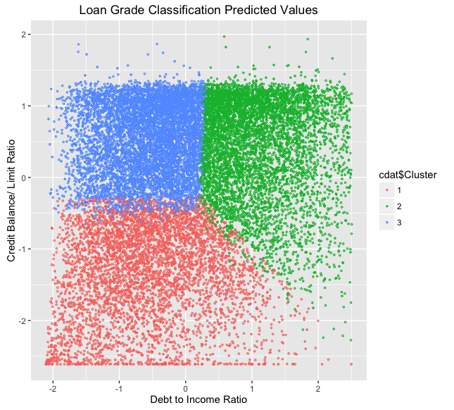

Slide 27
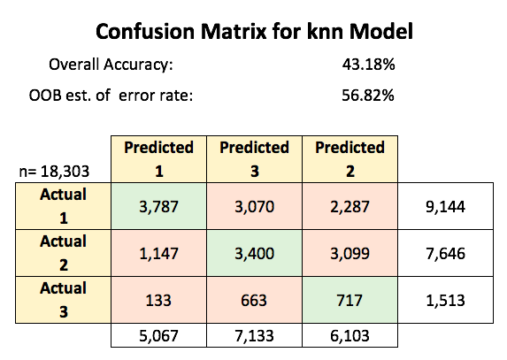

Slide 28
Thank You

